Slide 1


Cloud Computing Characteristics and Benefits for Startup Ecosystems
Comparative Presentation on IaaS, PaaS, and SaaS for an Educational Institution
Why XaaS is Becoming a Dominant Consumption Model in Modern IT
CSA1522-Cloud Computing and Big Data Analytics
Presented By:
Sanjay kumar soy(192373005)
K. Dhilip(192365013)
T. Subahan(192511121)
Guided by:
Dr. Rajaram P

Slide 2
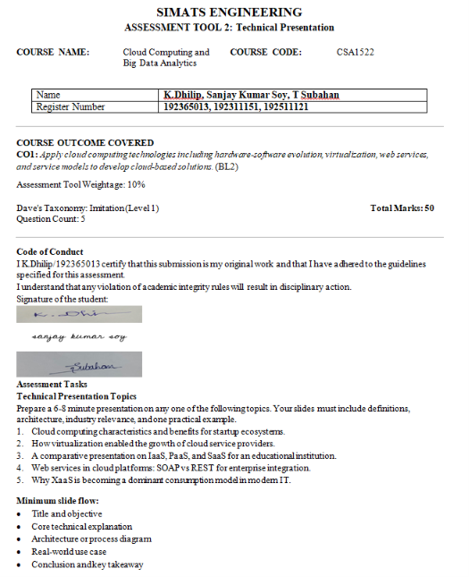

Slide 3
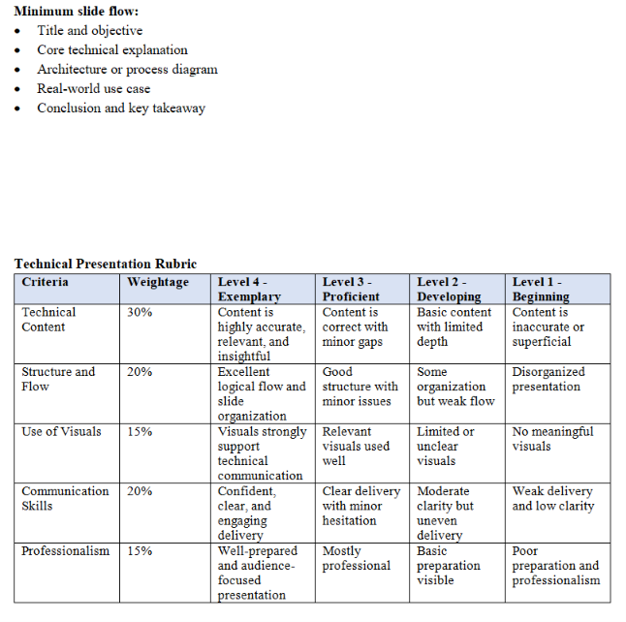

Slide 4
Cloud Computing Characteristics and Benefits for Startup Ecosystems
Title & Objective
Objective:
Understand cloud computing characteristics.
Learn how startups benefit from cloud services.
Explore real-world applications.
Core Technical Explanation
Characteristics
i.) On-demand self-service
ii.) Broad network access
iii.) Resource pooling
iv.) Rapid elasticity
v.) Measured service
Benefits for Startups
i.) Low initial investment
ii.) Faster deployment
iii.) High scalability
iv.) Automatic updates
v.) Global accessibility

Slide 5
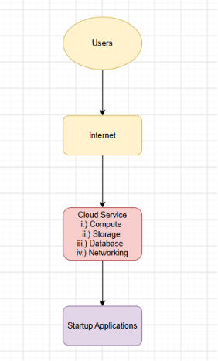
a
Architecture Diagram
Real-World Use Case
Startup: Netflix
Uses AWS cloud services.
Stores huge amounts of data.
Automatically scales during peak hours.
Delivers content worldwide.
Conclusion
Cloud computing reduces infrastructure cost.
Enables rapid business growth.
Ideal platform for startups.
Key Takeaway: Cloud computing helps startups innovate faster with lower investment.

Slide 6
Comparative Presentation on IaaS, PaaS, and SaaS for an Educational Institution
Title & Objective
Title: IaaS vs PaaS vs SaaS
Objective
Compare cloud service models.
Understand educational applications.
Core Technical Explanation
Examples:
IaaS – AWS EC2
PaaS – Google App Engine
SaaS – Google Classroom
IaaS | PaaS | SaaS
Infrastructure | Development Platform | Ready-to-use Software
User manages OS | User develops apps | Provider manages everything

Slide 7
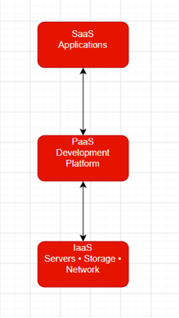
Architecture Diagram
Real-World Use Case
Educational Institution
IaaS → Virtual servers
PaaS → Student portal development
SaaS → Google Classroom, Microsoft 365
Conclusion
IaaS offers infrastructure.
PaaS supports development.
SaaS provides ready-to-use software.
Key Takeaway: Educational institutions can combine all three models effectively.

Slide 8
Why XaaS is Becoming a Dominant Consumption Model in Modern IT
Title & Objective
Title: Everything as a Service (XaaS)
Objective
Understand XaaS.
Learn why organizations adopt it.
Core Technical Explanation
XaaS Includes
SaaS , PaaS
IaaS
DBaaS
STaaS (Storage as a Service)
Advantages
Pay-as-you-use
High scalability
Low maintenance
Anywhere access

Slide 9
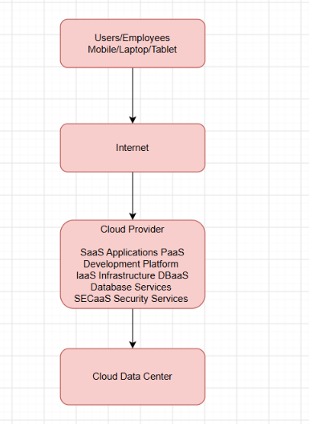
Architecture Diagram
Real-World Use Case
Company using XaaS
Microsoft 365 → SaaS
Azure → IaaS
Azure SQL → DBaaS
Azure AI → AIaaS
Benefits:
Reduced IT costs
Flexible scaling
Conclusion
XaaS provides all IT resources as services.
Organizations pay only for what they use.
Supports digital transformation.
Key Takeaway: XaaS is the future of modern IT because it offers flexibility, scalability, and cost efficiency.

Slide 10
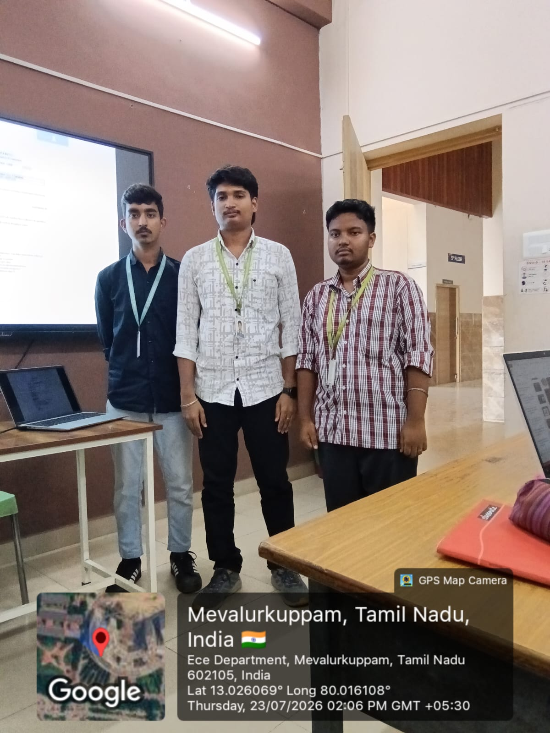
GPS Photo

Slide 11
